Slide 1

CI-PUSH THE AWESOME AND RIGHT WAY TO DO CI
Nikolaj Ougaard
IT Java & Tools specialist
Topdanmark

Slide 2

BACKGROUND
Implementing CI
The usual suspects:
Maven
Jenkins
Git
Proprietary CVCS
The server running the CVCS crashed!
Notes:
- Start Erlang install?
- We had some discussions on polling interval and initially decided to go with 10 minutes

Slide 3

THE PROBLEM
Polling
Each poll created a new connection,
eventually the server ran out of ram
Did the Math
Theoretically ~ 1.7 mio. polls / day
( ~ 20 polls / second )
> 99% of the polls are fruitless !
Notes:
- Start RabbitMQ install?
- The core problem was too many polls

Slide 4

THE SOLUTION - THEORY
Push
No P2P integration
Loosely coupled
Multiple interfaces
Robust delivery
Filtering mechanism
Open source
Notes:
Start Mule install?
Thought about creating a server solution that would be polled instead
Thought about a P2P integration – but then what about Git
P2P and loosely coupled asks for an ESB
Robust delivery calls for MQ
Filtering is achived by using Topic’s

Slide 5
THE SOLUTION - PRACTICE
CI-Push
VCS
PUSH SERVER
CI
Git
Proprietary
hook
file
ESB
hpi
Jenkins
hook
MuleESB
Mule Flow
CVS
Subversion
Jazz
Mercurial
…
http
topic
?
Hudson
TeamCity
Bamboo
…
?
?
?
queue
?
?
?
AMQP
RabbitMQ
This is awesome !
All is available today at https://github.com/nikolajo/ci-push
Notes:
Deploy mule flow
Explain Push Server / plugins

Slide 6
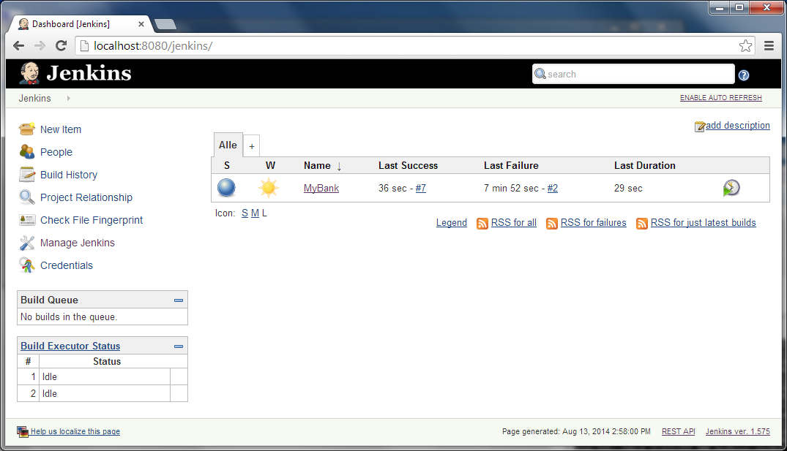
DEMO

Slide 7
KEY TAKE AWAYS
CI-Push
Instantaneous builds
No polling
Open source
= The AWESOME and right way to do CI

Slide 8

WOULD YOU LIKE TO KNOW MORE?
https://github.com/nikolajo/ci-push
realcipush@gmail.com

